Slide 1
Intro to fpga
Mateusz wolak

Slide 2
Software vs hardware design
Software
hardware
The development and testing of programs/code
Instructions given to a computer, which is interpreted into physical signals
Think: loops and classes
The development and testing of physical computer systems
The design of the actual physical hardware software runs on, ie. processors
Think: logic gates and integrated circuits

Slide 3

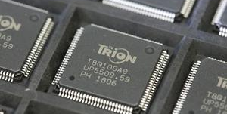
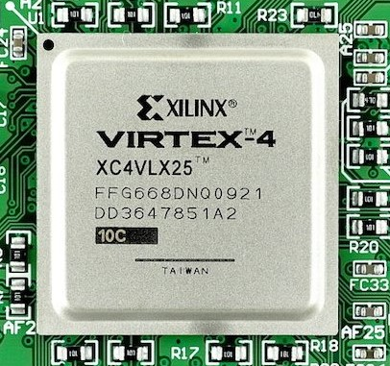
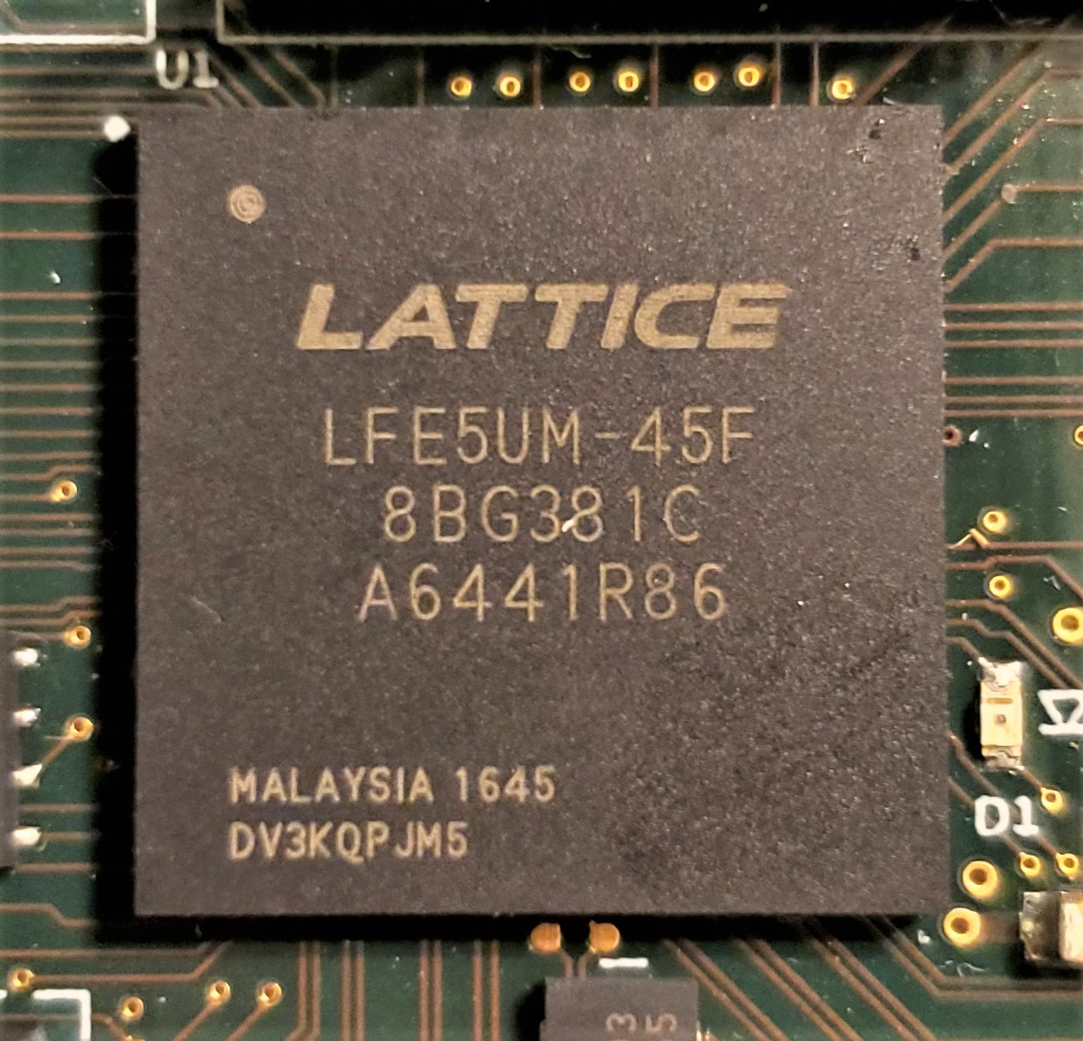
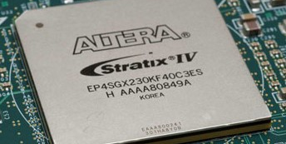
What is fpga?
Stands for field-programmable gate array
Comes from the fact that they can be reprogrammed “in the field”
FPGAs are pieces of re-configurable computer hardware
You specify a circuit, and the FPGA is configured to match that design – this can be as simple as 1 logic gate, or as complex as entire multicore processors
Produced by 4 major vendors: Xilinx, Altera (intel), Lattice, and Efinix
Can cost anywhere from $1 to $91,000

Slide 4
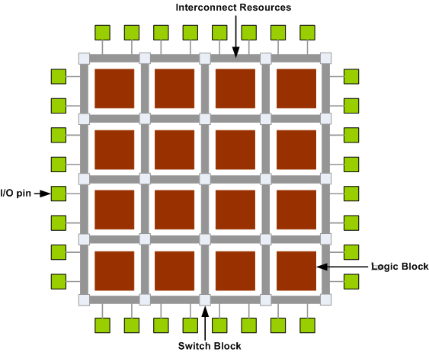
Basic architecture
Programmable logic blocks – implement basic logic functions
Combinatorial logic - and, or, xor …
Flip-flops – store output from combinatorial logic
Specialized blocks (ie. memory) – vendor specific
Programmable interconnects – link logic blocks together as specified
Programmable I/O – make off-chip connections

Slide 5
Workflow - Programming
FPGA
Software
Designs are specified using HDLs (hardware description languages), such as Verilog and VHDL
Designs are specified with high-level programming languages, such as C++, Java, and Python

Slide 6
Workflow - compilation
FPGA Steps
Software Steps
Synthesis – Verilog is converted into a netlist, which describes the basic blocks (primitives) needed (think a recipe)
Place & Route (P&R) – Netlist is mapped to the primitives physically present on the FPGA (matching to the ingredients you have)
Bitstream generation – Results of P&R are translated into a format the FPGA can read from flash memory (hex)
Compiler – High-level programming language is converted into instructions the processor understands. (example: GNU compiler for C++)
Linker – combines the various compiled files in a project into one executable to run on the processor
Executable – .exe

Slide 7
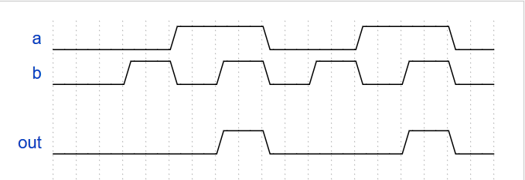
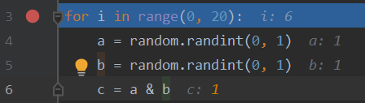
Workflow - Debugging
FPGA
Software
Debugging is done by looking at waveforms (physical signals)
Debugging is done by looking at data values (software constructs)

Slide 8
In the real world
Strengths
weaknesses
applications
Parallel processing – circuits on an FPGA can work completely independent of one another, greatly accelerating certain workloads
Reconfigurable – can be reprogrammed to a completely different hardware configuration quickly.
Configurable IO – easy to connect and swap various peripherals
Less space and energy efficient – because they are reconfigurable, they contain many elements you don’t use, eating up space and power
Low clock speed – generally, fast FPGAs clock in around 500 MHz, where current CPUS are pushing 5 GHz, not ideal for naturally sequential tasks
Used to design, prototype and test ASICS before and early in mass production
Overlap with ASIC - Image processing, DSP, aerospace & defense, medical systems, etc.
Reconfigurability makes it perfect for certain tasks – Microsoft is using FPGAs to run Bing search algorithms, so that they can be reconfigured as algorithms change
Notes:
Flexible IO

Slide 9
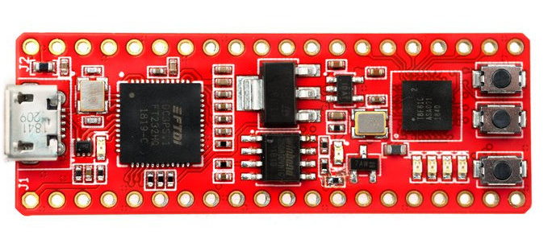
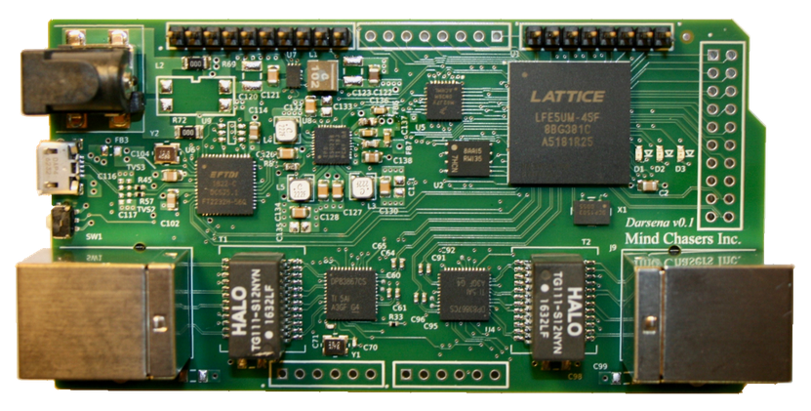
Fpga Board Examples
Fireant
Darsena (mind chasers)
The FPGA development board we will use in this workshop
Uses an Efinix Trion T8 FPGA (7k LE, 123Kb RAM)
Low-power and simple, making it perfect for getting started with FPGA
Low cost - $38 on Crowd Supply
Easy to use IDE for development
Uses Lattice ECP5-UM FPGA (44k LUT, 1944 Kb RAM)
Large and powerful chip, enabling advanced functionality (private island project)
Integrated ethernet PHYs, with 4-channel PCS/SERDES on the FPGA
Powerful IDE for development

Slide 10
Verilog HDL
Used to design a hardware configuration to be put onto the FPGA
HDL = hardware description language, NOT a programming language
With Verilog, don’t think of it in terms of coding – instead, you are specifying a hardware layout.

Slide 11
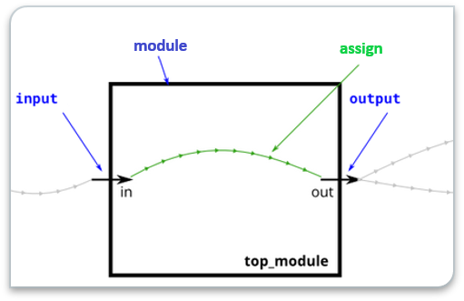
Basics
module – basic Verilog construct used to house logic. Has inputs & outputs, connecting them as specified by the logic.
assign – keyword used to connect elements in Verilog. The connection it describes is continuous.

Slide 12
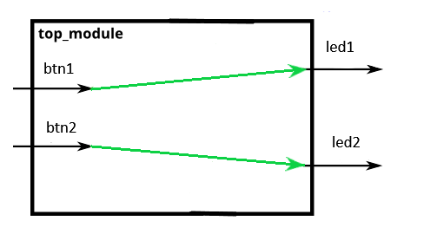
Basic example
module top_module (input btn1, input btn2, output led1, output led2);
assign led1 = btn1;
assign led2 = btn2;
endmodule;
Notes:
Show programming of board and click the buttons & stuff on webcam

Slide 13
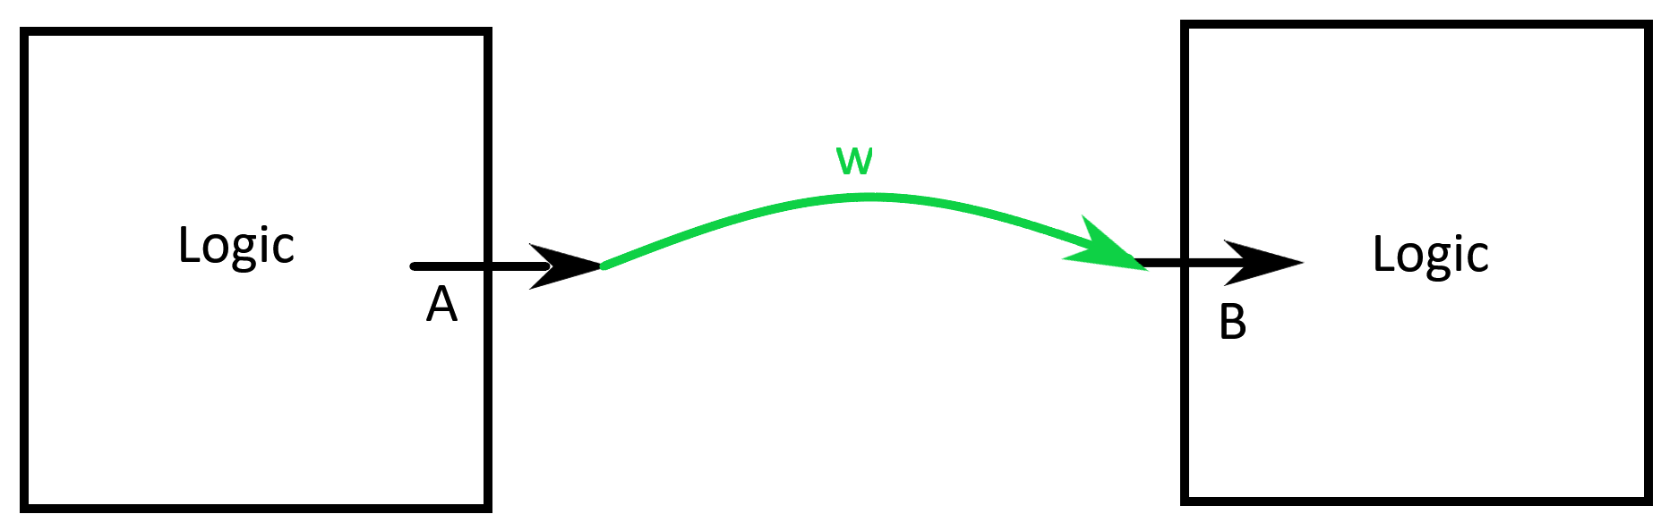
wire
Basic type in Verilog, symbolizes a wire (shocking) used to connect different elements w/ continuous assignment
In our previous example, the inputs and outputs were all implicitly type wire
Can also be declared explicitly to connect logic inside of a module like this:
wire w;
assign w = a
assign b = w

Slide 14
Operators
~ = NOT
& = AND
| = OR
^ = XOR
Applied to elements in expressions like so:
in1 & in2
in1 & ~in2 | in3
Etc.

Slide 15
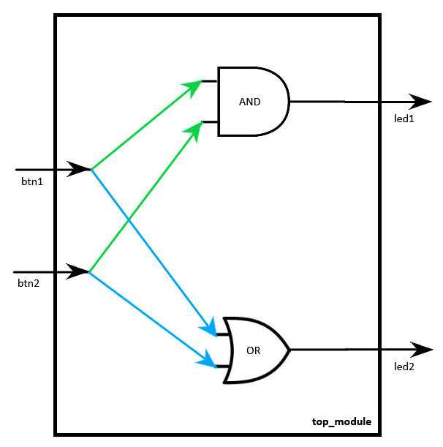
Practice
Task: create the circuit shown on the left using Verilog HDL.
Design:
led1 driven by AND operation of btn1 and btn2
Led2 driven by OR operation of btn1 and btn2
Notes:
Have them write the Verilog for this on their own

Slide 16
Solution
module top_module (input btn1, input btn2, output led1, output led2);
assign led1 = btn1 & btn2;
assign led2 = btn1 | btn2;
endmodule;
Notes:
If small group – have each person deploy to board and interact with the buttons – then show Verilog → bitstream
If large group – have each person compare their code, then go through and show everyone full process Verilog → bitstream and let them interact with the buttons

Slide 17
clock
External signal, generated by an oscillator
Used to synchronize the components in a circuit – synchronous computing
Generally, all operations happen on the rising edge

Slide 18
Binary values
Numbers represented in base 2, rather than base 10
Each place is called a “bit”
Each place represents a power of 2, with the right being lowest
2^3, 2^2, 2^1, 2^0
1011 → 11
Verilog syntax: 4’b11

Slide 19
register
Basic element used to store information
Holds its value until the next rising edge of the clock
In Verilog:
Uses “reg” keyword
Has a defined size, and stores a binary value
Syntax:
reg [15:0] reg_name = 16'b0;

Slide 20
Type groups
Two groups of types in Verilog
“Nets” are types for connecting components → continuous assignment
Wire belongs to this group
“Variables” are types for storing information → synced with clock
Reg belongs to this group
Notes:
Here, do 3-bit register counting example on the board

Slide 21
Always block
Container for defining synchronous logic within a module
“<=“ used for assignment
Everything inside must be “variable” type
Uses “always”, “posedge”, “begin” and “end” keywords
Syntax:
always @ (posedge clk) begin
a <= b;
end

Slide 22
Clock example
module top_module (input clk, output led1, output led2);
reg [15:0] clk_count = 16'b0;
assign led1 = (clk_count[15] & clk_count[14]);
assign led2 = ~(clk_count[15] & clk_count[14]);
always @ (posedge clk) begin
clk_count <= clk_count + 16'b1;
end
endmodule
Notes:
Again, show this on the board

Slide 23
Side note
Technically, the way we used the clock was incorrect
On power-up, the oscillator produces an unstable clock, and we don’t want to be performing any operations at this time
This is overcome with something called pll, which produces a signal when the clock is stable – we use this to delay operations
Additionally, our board should use a reset button – so that the contents of the register are in a known state

Slide 24
Proper example
module top_module (input pll_LOCKED, input pll_CLK, input btn1, output led1, output led2);
reg [25:0] clk_count;
assign led1 = (clk_count[25] & clk_count[24]);
assign led2 = ~(clk_count[25] & clk_count[24]);
always @ (posedge pll_CLK, negedge btn1) begin
if(btn1) begin
clk_count <= 26'b0;
end
else if (pll_LOCKED) begin
clk_count <= clk_count + 26'b1;
end
end
endmodule
Notes:
Again, show this on the board

Slide 25
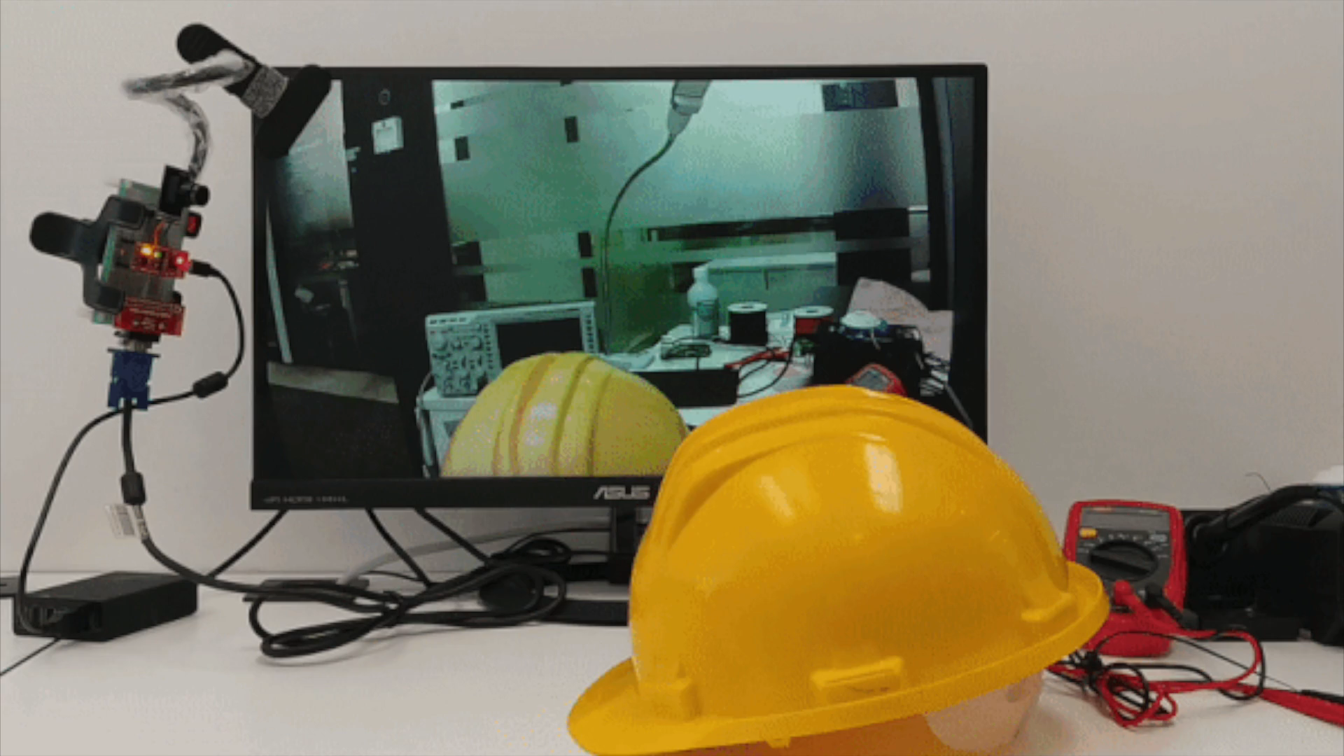
Demo
Notes:
Tell people how to get started

